Slide 2
Microsoft Teams Backend Services Powered by .NET Core
Marwa El-Dafrawy
Engineering Manager in Microsoft Teams

Slide 3
Agenda
Why did we move to .NET Core?
What services were migrated
.NET Core migration results
Approach taken during the migration
Key Learnings and Challenges
What's next after .NET Core migration?

Slide 4
Why .NET Core?
Performance and cost-efficiency improvements
Cross-Platform Support
Ability to host on Kestrel and Docker
Support for latest transports like Http/3 QUIC
Testability
Built-in dependency injection
Notes:
- Optimized implementation of low-level classes that bring performance improvements
- Ability to develop and run on Windows and Linux
Kestrel is cross platform and better request processing performance
-
HTTP/3 is the third and upcoming major version of HTTP.
HTTP/3 uses the same semantics as HTTP/1.1 and HTTP/2:
the same request methods,
status codes, and message fields apply to all versions. The differences are in the underlying transport. Both HTTP/1.1 and HTTP/2 use TCP as their transport. HTTP/3 uses a new transport technology developed alongside HTTP/3 called QUIC.
HTTP/3 and QUIC have a number of benefits compared to HTTP/1.1 and HTTP/2:
- Faster response time of the first request - Improved experience when there is connection packet loss.
- Supports transitioning between networks.
TestServer class was introduced, which is provided by ASP.NET Core in the Microsoft.AspNetCore.TestHost library to simulate ASP.NET Core applications for testing purposes.
A lightweight, high performance, and modular HTTP request pipeline
Side-by-side versioning
Open Source and community-focused
A cloud ready, environment-based configuration system

Slide 5
How many services are running on .NET Core?
122 services are planned for migration
37 services were successfully migrated to .NET Core in the past 2 years
30 services are work in progress
Broker Service
Transport used to send notifications from server to client
Broker is designed as a Pub-Sub model
Broker processes around 63 Billion requests a day
Conversation Service
Managing modalities for Signaling services
Processes around 600 billion requests a day
Notes:
IC3 Intelligent Conversation and Communications Cloud
Sending simple messages between endpoints
30% done

Slide 6
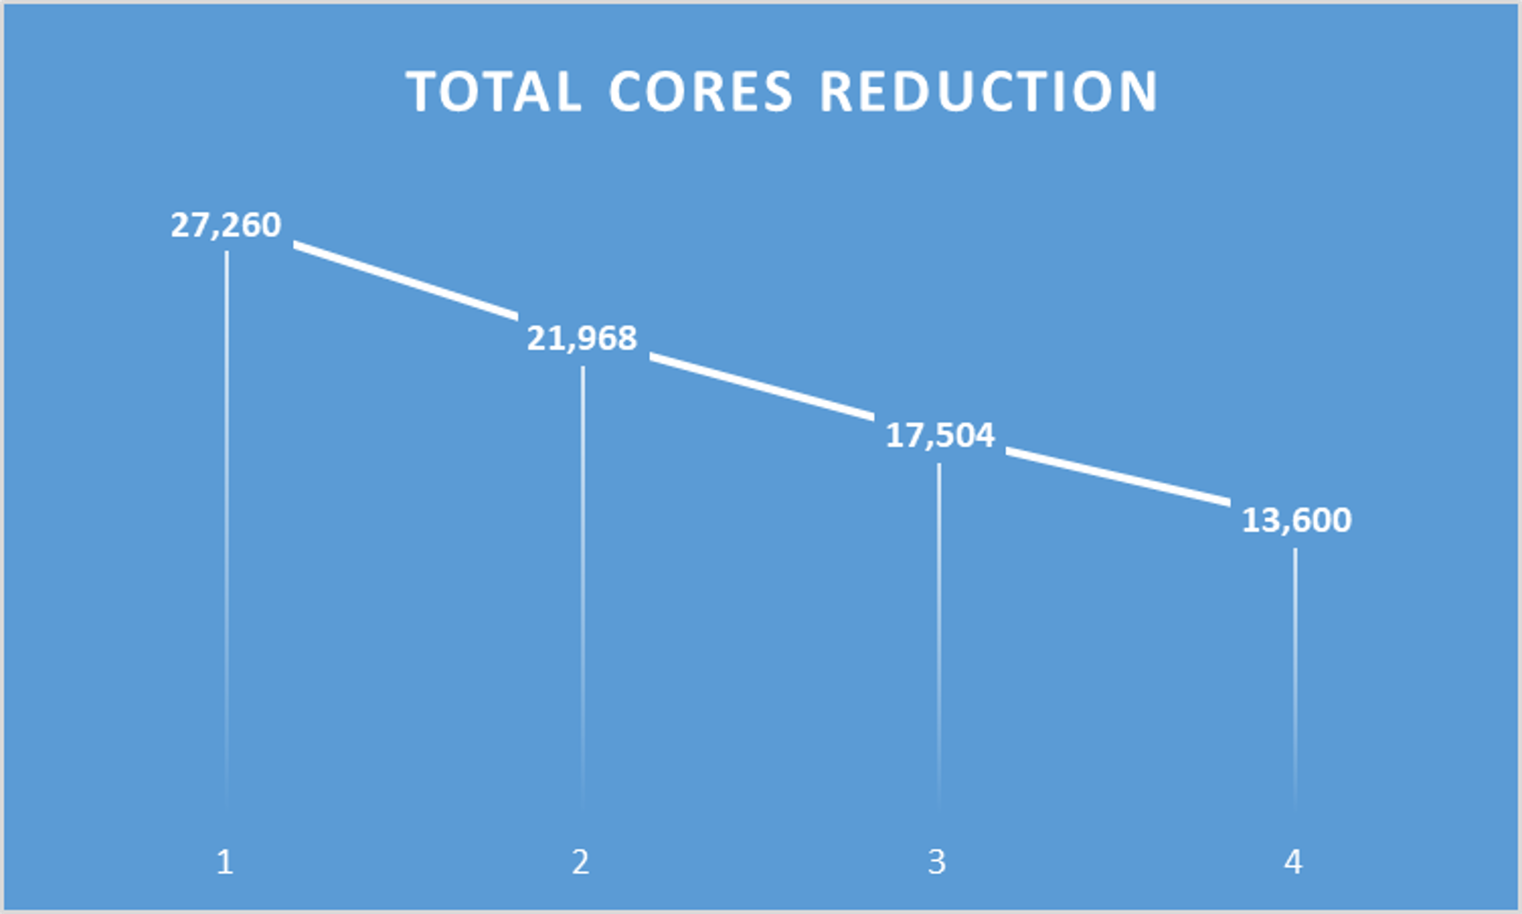
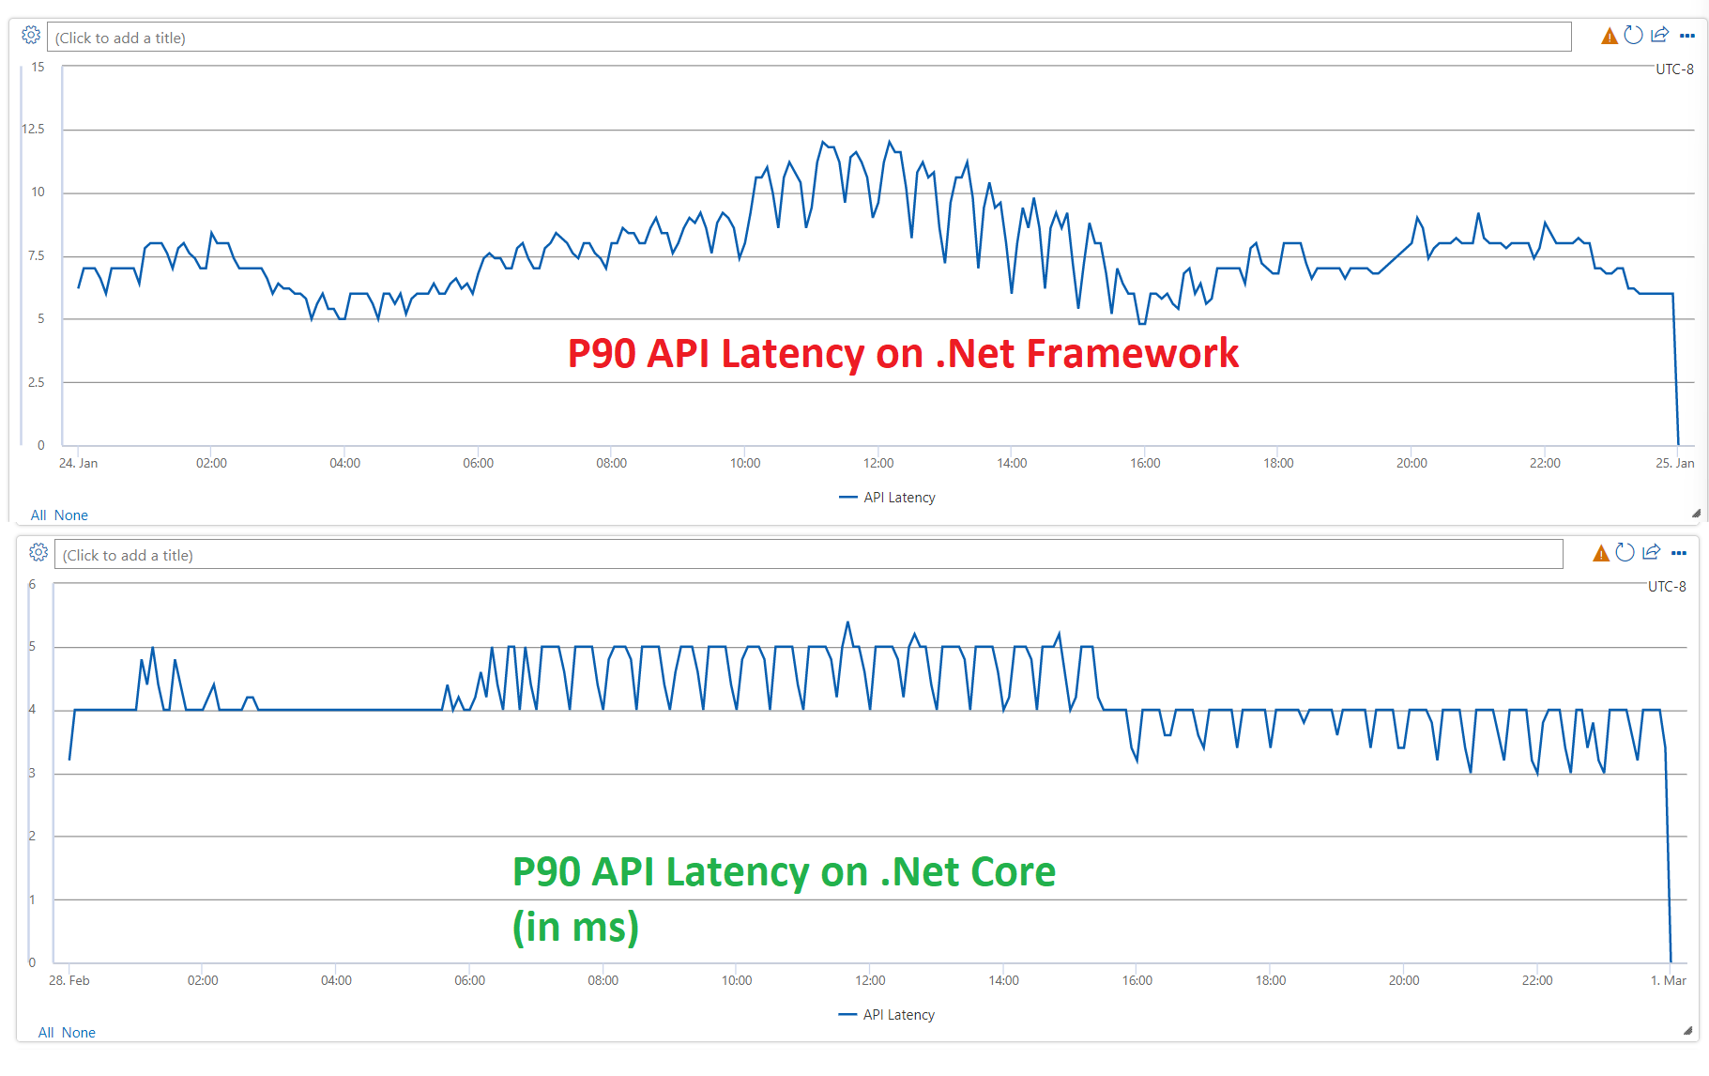
Broker Results
50% Reduction in Total Cores
60% Reduction in API latencies
$0.5 million annual cost savings
Notes:
16 ms to 5ms

Slide 7
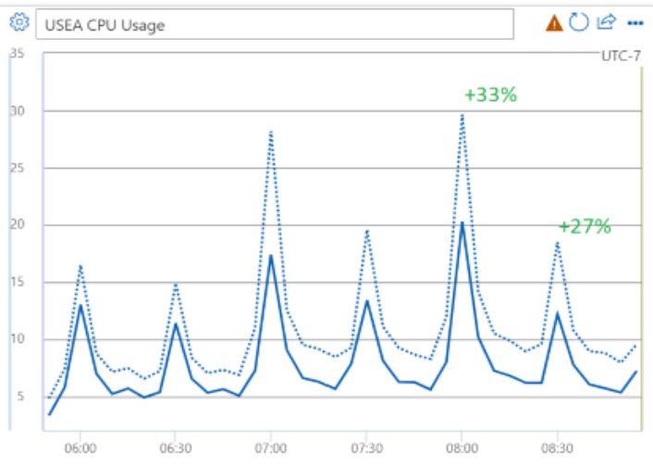
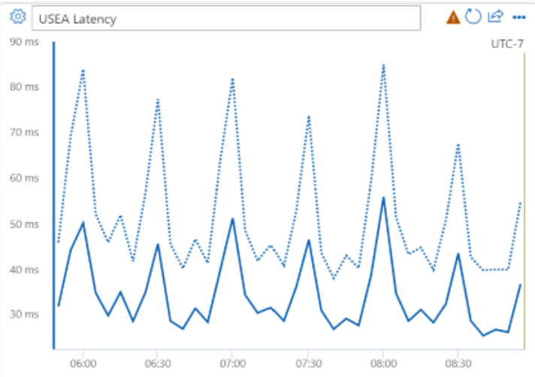
Conversation Service Results
25-35% CPU Improvements
20-30% Join Meeting Latency Improvements
$1.25 million annual cost savings
Notes:
33% to 27 %
90 ms to 50 ms

Slide 8
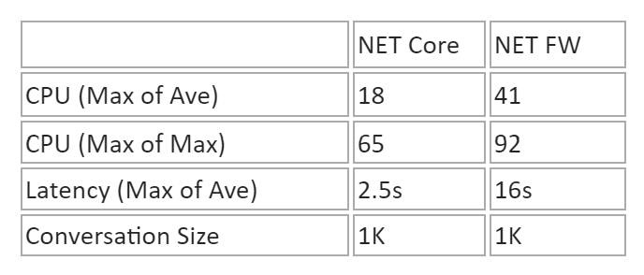
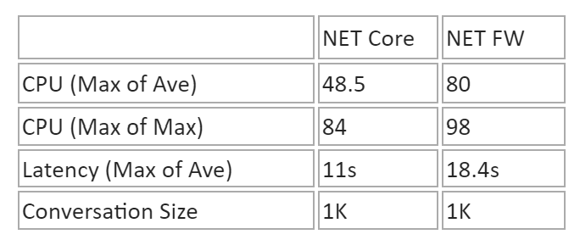
Large Meetings Results
40%-56% CPU improvement
40%-80% Join and Create Conversation Latency improvements
Notes:
Better reliability for large meetings
Better experience during meeting joins and mid-meetings activities

Slide 9
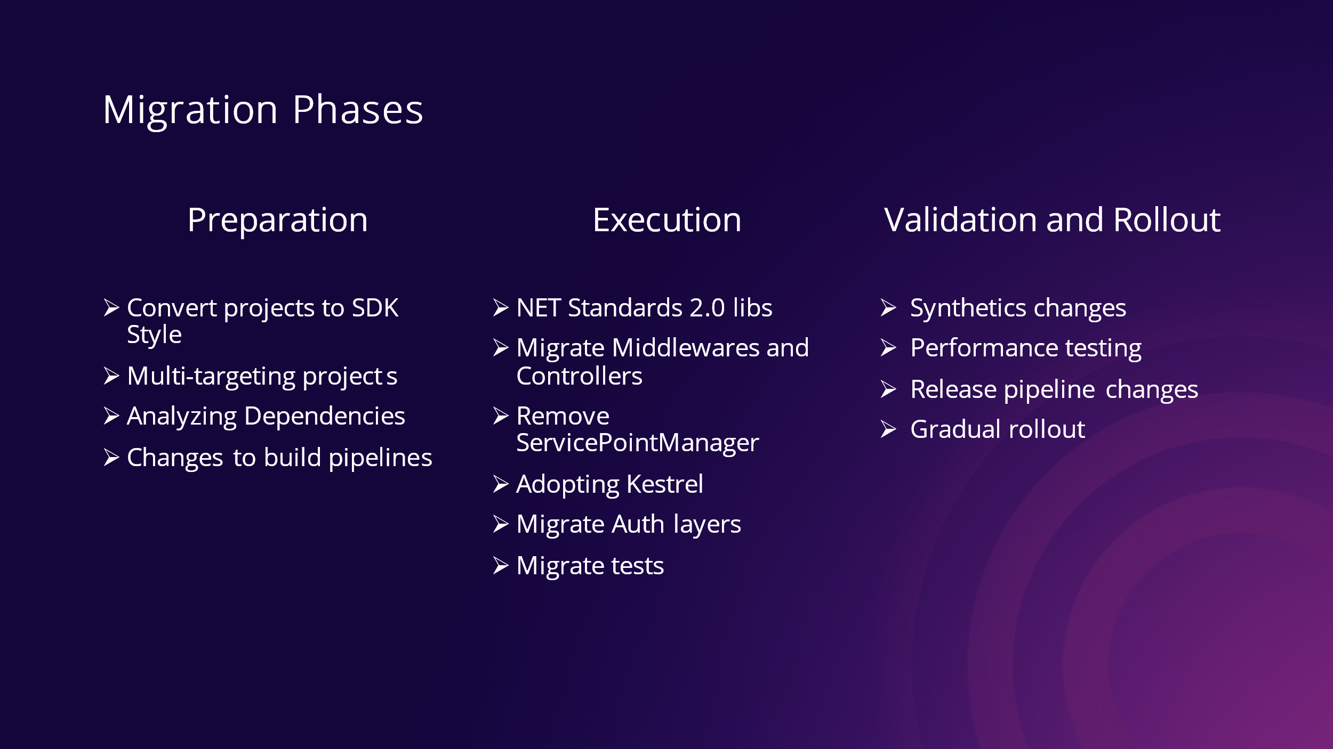
Notes:
Performance testing: Fine tune some of the configs
GC settings
Number of requests supports
Release pipeline changes:
1- Weekly releases
2- Support rollout for both .NET Core and .NET FW
3- Every build goes through different stages starting with releasing the build to internal teams, then everyone in Microsoft Teams, then Microsoft users, then world wide
4- Only subset of clusters in every stage were enabled on .NET Core
Gradual Rollout
5- The image will include both .NET Core and .NET FW to make it easier to rollback in case of issue

Slide 10
Learnings and Challenges
GetHashCode is not consistent for strings and other value types
UnityServiceProvider and Dependency Injection
Upgrade from .NET Core 3.1 to .NET Core 6
Support for NonValidatedHeader
Support for DelayCertificate ClientAuthenticationMode
HttpRequestMessage.Headers is not thread safe in .NET Core 6
Built-in Controller responses do not return valid JSON for errors
NET Core defaults to chunked encoding
Use of TestServer for UDP transport
Notes:
GetHashCode is not consistent for strings and other value types in .NET Core, where this was used to index Redis shards, it caused split meetings. We needed to update such usages to use a consistent hash. Difficult to repro because all tests environments had only one shard
There was a fix for a performance issue with Unity, where if we use UnityServiceProvider, the cost of creating and especially disposing the child scope was very high since it was implemented as a Unity child container.This was noticed only in .NET Core because child scopes are always created by the framework for managing its own dependencies, this is not the case in netfw
Upgrade to .NET Core 6 after the rollout
After rolling out NET Core to prod, we discovered an issue where DelayCert ClientCertificateMode should be used for both endpoints that need to support both anonymous, and non-anonymous workflows However DelayCert was only supporte in NET Core 6.
We make use of invalid Via headers in some of our partner services. To turn of the validation of these headers during proxying, we needed to upgrade CI to .NET 6.
HttpRequestMessage.Headers is not thread safe in .NET 6 (fixed in .NET 7), in metrics and elsewhere we were making concurrent reads to these headers resulting in exceptions. We needed to make such usages synchronous.
Built-in Controller responses do not return valid JSON for errors (return plain-text) We needed to create custom action result for valid JSON.
.NET Core defaults to chunked encoding, which is not supported by some of our partner services, due to a bug in .NET Framework in proxying chunked responses. So we needed to set the Content-Length on all responses to ensure chunked encoding was not activated. In certain compressed outbound scenarios, chunked encoding was enabled as a performance optimization to avoid re-buffering the request after compression.
We needed an in-memory server for our custom UDP transport, so we made use of TestServer in production
In netfw we:
Receive an HttpRequestMessage as a UDP Packet
Make use of HttpServer to route this request to the incoming handler/web api layer
The two initial approaches we were exploring were:
Using a custom middleware to inject the next delegate into our UDP listener
Using the existing TestServer as a composite Server to translate the requests

Slide 11
Other Learnings and Challenges
Build expertise on .NET Core
Do not disrupt continuous development and features
Team members working in parallel without getting blocked on eachother
Gradual Rollout of NET Core while still supporting .NET FW
Notes:
Spent time at the beginning learning about best practices, communicating to other teams, learn from past mistakes.
Cross-pollination
In line changes with pre-processor directives
Broker, branched off of master and then had a giant PR at the end
CS, committing changes in master
Used pre-processor directives
Weekly releases
Monitoring in place
Rollback instantly in case of issues
Once it hits production we wanted to make sure no customer impact

Slide 12
What’s Next?
Moving migrated services to Linux
Upgrading from Http/1 and Http/2 to Http/3 with Quic
Upgrading to .NET Core 7
Notes:
We already migrated one service to Linux
Will start working on the rest of services
Containerization performs better in Linux
Http3 with Quic is work in progress
.NET Core 7:
Supports having different processing queues for short running vs long running
Fixes some race conditions
Auth improvements

